Slide 1
External Features of Plants
By PETER
Based on “Botany Basics”, a module by Fed. Uni. Lafia .

Slide 2
Plant Organs
External plant structures such as leaves, stems, roots, flowers, fruits, and seeds are known as plant organs.
Each organ is an organized group of tissues that works together to perform a specific function
These structures can be divided into two groups: sexual reproductive and vegetative.
Sexual reproductive parts produce seed
They include flower buds, flowers, fruit, and seeds.
Vegetative parts include roots, stems, shoot buds, and leaves
They are not directly involved in sexual reproduction.
Vegetative parts often are used in asexual forms of reproduction such as cuttings, budding, or grafting.

Slide 3
Roots
It is important to understand plant root systems because they have a pronounced effect on a plant's size and vigor, method of propagation, adaptation to soil types, and response to cultural practices and irrigation.
Their principal functions are to…
absorb nutrients and moisture
anchor the plant in the soil
support the stem
store food.
In some plants, roots can be used for propagation.

Slide 4
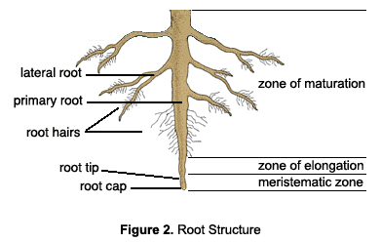
Root Structure

Slide 5
Root Structure
Internally, there are three major parts of a root (Figure 2):
The meristem is at the tip and manufactures new cells; it is an area of cell division and growth.
Behind the meristem is the zone of elongation. In this area, cells increase in size through food and water absorption. As they grow, they push the root through the soil.
The zone of maturation is directly beneath the stem. Here, cells become specific tissues such as epidermis, cortex, or vascular tissue.

Slide 6
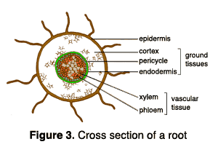
Cross Section of a Root

Slide 7
Root Cross Section
A root's epidermis is its outermost layer of cells
These cells are responsible for absorbing water and minerals dissolved in water.
Cortex cells are involved in moving water from the epidermis to the vascular tissue (xylem and phloem) and in storing food.
Vascular tissue is located in the center of the root and conducts food and water.

Slide 8
External Root Sections
Externally, there are two areas of importance: the root cap and the root hairs
The root cap is the root's outermost tip.
It consists of cells that are sloughed off as the root grows through the soil.
Its function is to protect the root meristem.
Root hairs are delicate, elongated epidermal cells that occur in a small zone just behind the root's growing tip.
They generally appear as fine down to the naked eye.
Their function is to increase the root's surface area and absorptive capacity.
Root hairs usually live 1 or 2 days.
When a plant is transplanted, they are easily torn off or may dry out in the sun. This will severely disrupt the plant’s absorption abilities.

Slide 9
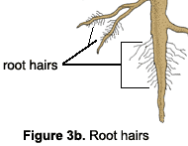
Root Hairs and Mycorrhizae
Many roots have a naturally occurring symbiotic (mutually beneficial) relationship with certain fungi,
This improves the plant's ability to absorb water and nutrients.
This beneficial association is called mycorrhizae

Slide 10
Types of Roots
There are two major types of roots: primary and lateral.
A primary root originates at the lower end of a seedling's embryo.
If the primary root continues to elongate downward, becomes the central feature of the root system, and has limited secondary branching, it is called a taproot
Hickory and pecan trees, as well as carrots, have taproots.
A lateral, or secondary, root is a side or branch root that arises from another root.
If the primary root ceases to elongate, and numerous lateral roots develop, a fibrous root system is formed.
These lateral roots branch repeatedly to form the network of feeding roots found on most plants.

Slide 11
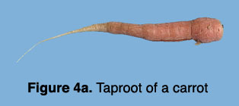
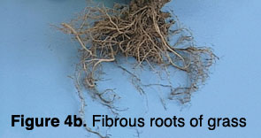
Taproots vs. Fibrous Roots

Slide 12
Taproot → Fibrous Root
Some plants, such as grasses, naturally produce a fibrous root system.
In other cases, severing a plant's taproot by undercutting it can encourage the plant to produce a fibrous root system.
Nurseries use this technique with trees that naturally produce a taproot because trees with a compact, fibrous root system are transplanted more successfully.
I.e. a taproot plant can become a fibrous root plant with proper severing techniques

Slide 13
How Roots Grow
During early development, a seedling absorbs nutrients and moisture from the soil around the sprouting seed.
A band of fertilizer several inches to each side and slightly below newly planted seeds helps early growth of most row crops.
As a plant becomes well established, its ability to absorb moisture and nutrients is most dependent on…
The quantity of roots it has
How the roots are distributed
For most plants, the majority of the absorbing (feeder) roots are located in the top 12 inches of soil.
The soil environment in this region generally is best for root growth, with a good balance of fertility, moisture, and air spaces.

Slide 14
Root Growth Factors
The following factors are important in root growth:
Roots in water-saturated soil do not grow well and ultimately may die due to lack of oxygen.
Roots penetrate much deeper in loose, well-drained soil than in heavy, poorly drained soil.
A dense, compacted soil layer can restrict or terminate root growth.
Container plants not only have a restricted area for root growth, but also are susceptible to cold damage because the limited amount of soil surrounding their roots may not provide adequate insulation.
In addition to growing downward, roots grow laterally and often extend well beyond a plant's dripline.
Keep this extensive root system in mind when disturbing the soil around existing trees and shrubs.

Slide 15
Roots as Food
An enlarged root is the edible portion of several vegetable crops.
Sweet potatoes are a swollen tuberous root
Carrots, parsnips, and radishes are elongated taproots.

